Slide 1

Operating Systems BCSC 0004
Processes Synchronization

Slide 2
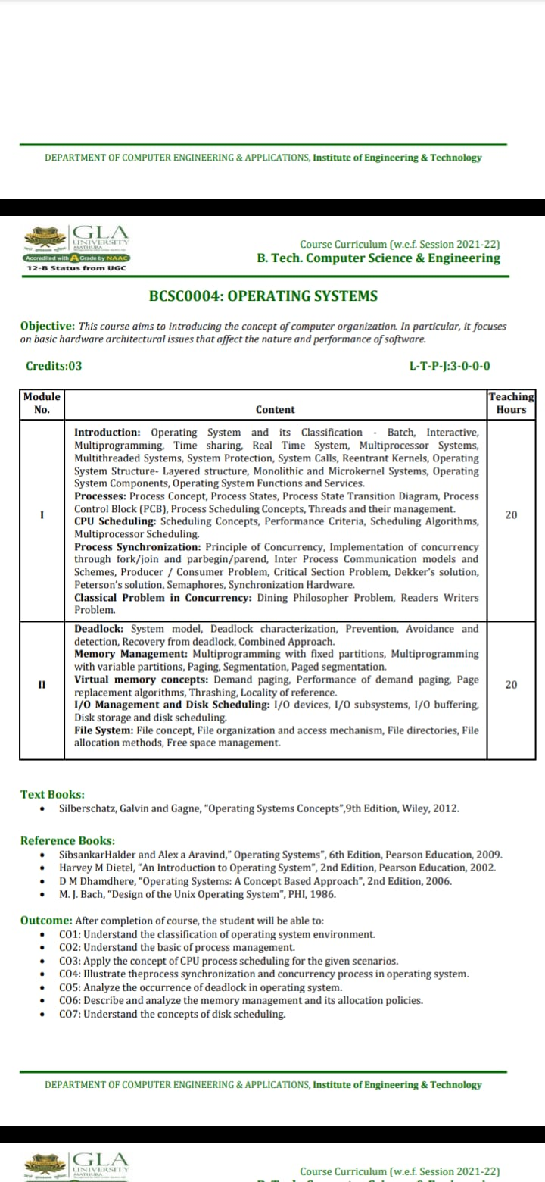

Slide 3
Process Synchronization
Two types Process
Independent process: Execution of the process does not affect the execution of other.
Cooperative process: Execution of one process affects the execution of other process.
Process Synchronization: It helps to maintain shared data consistency & cooperating process execution. When process execute, it should be ensure that, those concurrent access to shared data does not create inconsistency.

Slide 4
Race condition
In an O.S., the processes that are working together shared some common storage (main memory file) that each process can read and write, when two or more processes are reading or writing some shared data and the final result depending on who run precisely when, are called race conditions.
Several processes access and manipulate the same data concurrently and the outcome of the execution depends on the particular order in which the access takes place, is called a race condition.
Race condition are also possible in O.S. if the ready queue is implemented as a linked list and if the ready queue is manipulated during the handling of other interrupt before the first one completes. If the interrupts are not disable then the linked list could become corrupted.

Slide 5
How to avoid race condition?
The key to preempting trouble involving shared storage is to find some way to prohibit more than one process from reading and writing shared data simultaneously.
That part of the program where the shared memory is accessed is called the critical section.
To avoid race conditions and flowed results one must identify codes in critical section in each thread.

Slide 6
Critical section:
When more than one processes access a same code segment that segment is known as critical section. Critical section contains shared variables or resources which are needed to be synchronized to maintain consistency of data variable.
The portion in any program that accesses a shared resource is called as critical section (or) critical region.

Slide 7
A solution to the critical section problem must satisfy the following 3 requirements:
1.mutual exclusion:
Only one process can execute their critical section at any time.
2. Progress:
When no process is executing a critical section for a data, one of the processes wishing to enter a critical section for data will be granted entry.
3. Bounded wait:
No process should wait for a resource for infinite amount of time.

Slide 8
Peterson’s solution:
Peterson solution is one of the solutions to critical section problem involving two processes. This solution states that when one process is executing its critical section then the other process executes the rest of the code and vice versa.
Peterson solution requires two shared data items:
1) turn: indicates whose turn it is to enter into the critical section. If turn == i ,then process i is allowed into their critical section.
2) flag: indicates when a process wants to enter into critical section. when process i wants to enter their critical section, it sets flag[i] to true.
do {
flag[i] = TRUE; turn = j;
while (flag[j] && turn == j);
critical section
flag[i] = FALSE; remainder section
} while (TRUE);

Slide 9
Peterson’s solution:
Process P0 | Process P1
While(1) { flag [0] = T turn = 1 While(turn ==1 && flag[1]==T); Critical section flag[0] = F } | While(1) { flag [1] = T turn = 0 While(turn ==0 && flag[0]==T); Critical section flag[1] = F }

Slide 10
Semaphores
Semaphores are integer variables that are used to solve the critical section problem by using two atomic operations, wait and signal that are used for process synchronization.
The definitions of wait and signal are as follows −
Wait The wait operation decrements the value of its argument S, if it is positive. If S is negative or zero, then no operation is performed.
Signal The signal operation increments the value of its argument S.
Process P_{i} | Wait (S) | Signal (S)
do { Entry Section Critical Section Exit Section Remainder Section } while(T); | Wait(S) { While(s<=0); S = S-1; } | Signal (S) { S = S+1 }

Slide 11
Types of Semaphores
There are two main types of semaphores i.e. counting semaphores and binary semaphores. Details about these are given as follows −
Counting Semaphores These are integer value semaphores and have an unrestricted value domain. These semaphores are used to coordinate the resource access, where the semaphore count is the number of available resources. If the resources are added, semaphore count automatically incremented and if the resources are removed, the count is decremented.
Binary Semaphores The binary semaphores are like counting semaphores but their value is restricted to 0 and 1. The wait operation only works when the semaphore is 1 and the signal operation succeeds when semaphore is 0. It is sometimes easier to implement binary semaphores than counting semaphores.

Slide 12
Advantages of Semaphores
Semaphores allow only one process into the critical section. They follow the mutual exclusion principle strictly and are much more efficient than some other methods of synchronization.
There is no resource wastage because of busy waiting in semaphores as processor time is not wasted unnecessarily to check if a condition is fulfilled to allow a process to access the critical section.
Semaphores are implemented in the machine independent code of the microkernel. So they are machine independent.

Slide 13
Producer Consumer Problem
The producer consumer problem is a synchronization problem. There is a fixed size buffer and the producer produces items and enters them into the buffer. The consumer removes the items from the buffer and consumes them.
A producer should not produce items into the buffer when the consumer is consuming an item from the buffer and vice versa. So the buffer should only be accessed by the producer or consumer at a time.

Slide 14
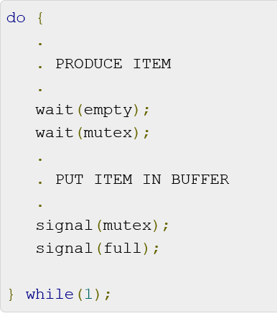
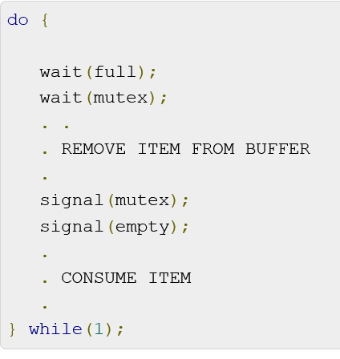
Producer Process
The code that defines the producer process is given below −
Consumer Process
The code that defines the consumer process is given below:

Slide 15
Monitor
Monitor is one of the ways to achieve Process synchronization. Monitor is supported by programming languages to achieve mutual exclusion between processes. For example Java Synchronized methods. Java provides wait() and notify() constructs.
It is the collection of condition variables and procedures combined together in a special kind of module or a package.
The processes running outside the monitor can’t access the internal variable of monitor but can call procedures of the monitor.
Only one process at a time can execute code inside monitors.

Slide 16
Components of Monitor
There are four main components of the monitor:
Initialization: – Initialization comprises the code, and when the monitors are created, we use this code exactly once.
Private Data: – Private data is another component of the monitor. It comprises all the private data, and the private data contains private procedures that can only be used within the monitor. So, outside the monitor, private data is not visible.
Monitor Procedure: – Monitors Procedures are those procedures that can be called from outside the monitor.
Monitor Entry Queue: – Monitor entry queue is another essential component of the monitor that includes all the threads, which are called procedures.

Slide 17
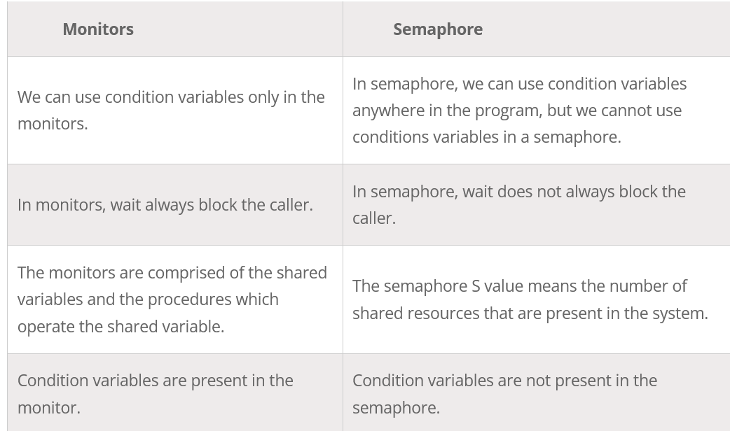
Difference between Monitors and Semaphore

